Slide 1
NumSim Projekt
Multigrid-Verfahren

Slide 2
Inhalt
Codearchitektur
Code Features
Parameterstudie
Behandlung der Nichteindeutigkeit des Neumann-Poissonproblems
Anwendung
Ausblick

Slide 3
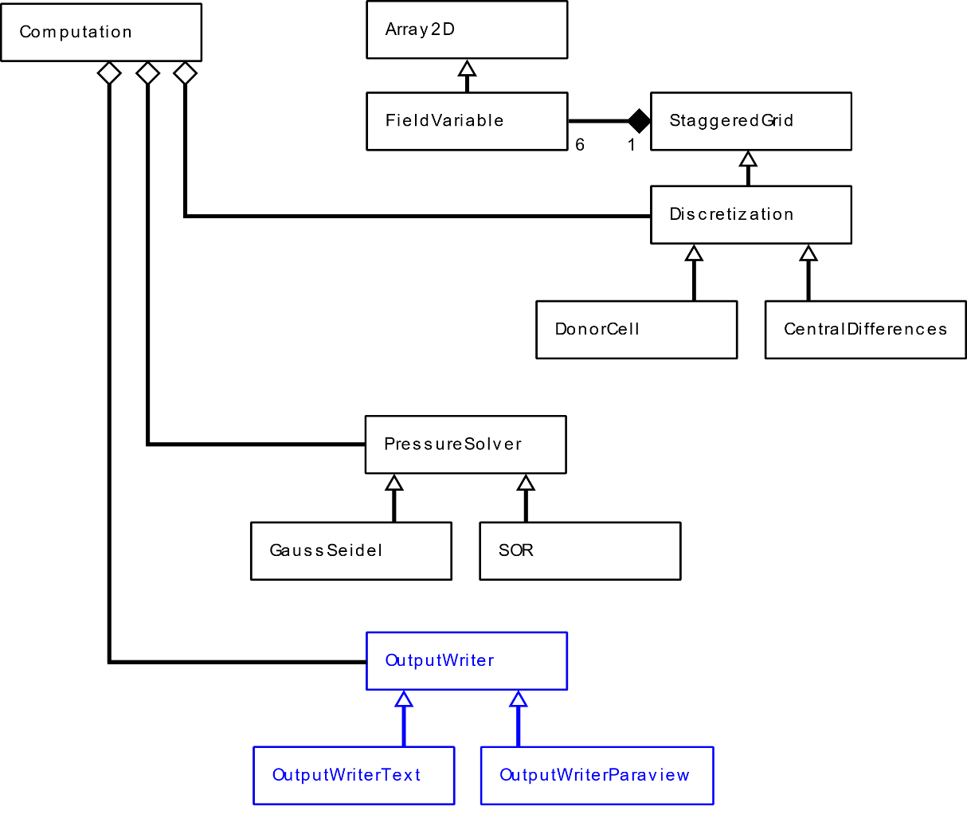
Codearchitektur

Slide 4
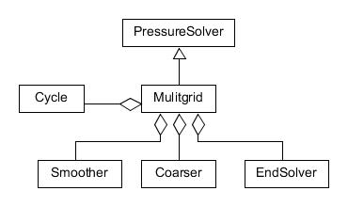
Codearchitektur

Slide 5
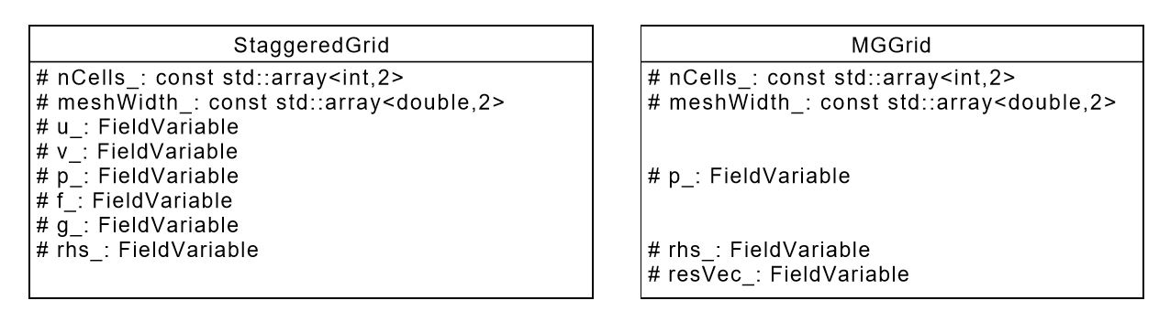
Datenstruktur

Slide 6
Code Features
Smoother
number
Coarser
EndSolver
Cycle

Slide 7
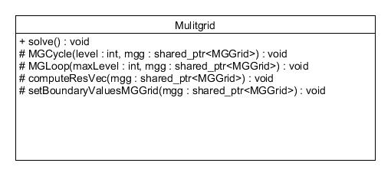
Multigrid

Slide 8
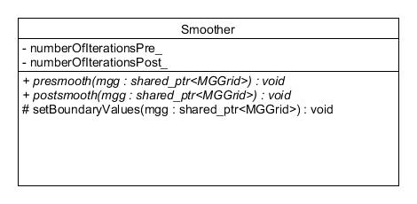
Smoother

Slide 9
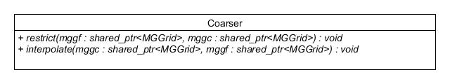
Coarser

Slide 10
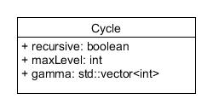
Cycle

Slide 11
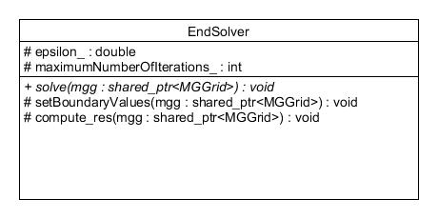
EndSolver

Slide 12
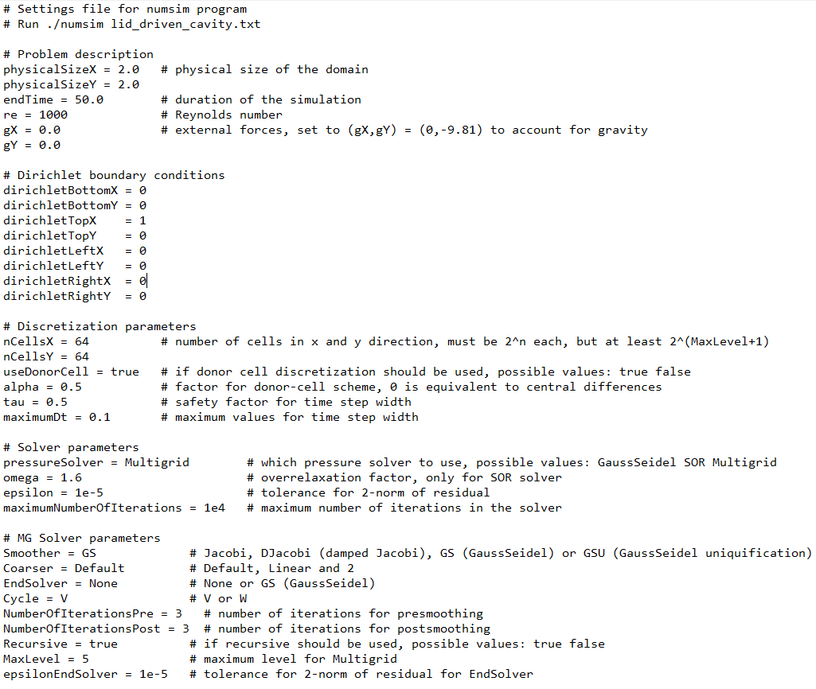

Slide 13
Motivation erste Sekunde anschauen

Slide 14
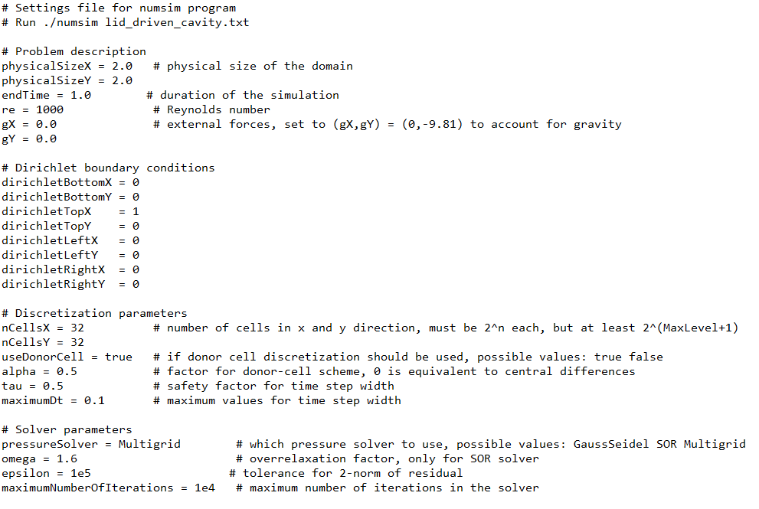

Slide 15
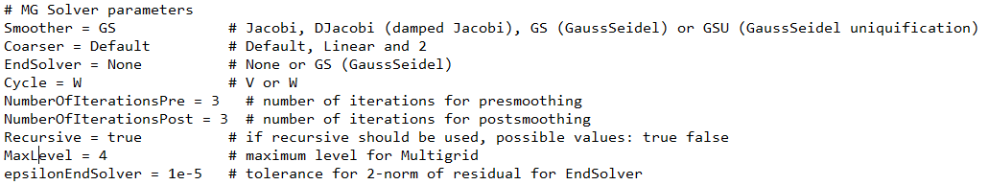
compare_ouput Resultate
GaussSeidel | 6.78027e-8
Jacobi | 1.03668e-4
Gedämpfter Jacobi (0.5) | 1.133

Slide 16
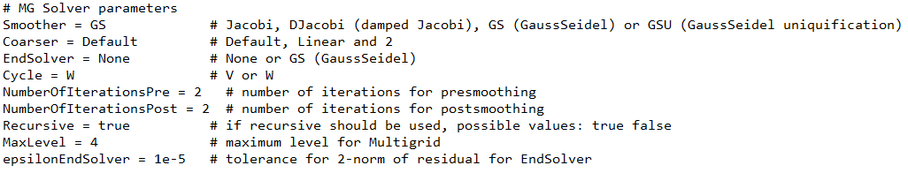

compare_ouput Resultate
Cycle = V, MaxLevel = 1 | 8.68051e-4 | Faktor Level | Faktor Cycle
Cycle = V, MaxLevel = 2 | 1.66553e-4 | 0,192
Cycle = V, MaxLevel = 3 | 2.32547e-5 | 0,140
Cycle = V, MaxLevel = 4 | 3.04163e-6 | 0,131
Cycle = W, MaxLevel = 1 | 8.68051e-4 |  | 1
Cycle = W, MaxLevel = 2 | 7.15573e-5 | 0,082 | 0,430
Cycle = W, MaxLevel = 3 | 2,83070e-6 | 0,040 | 0,122
Cycle = W, MaxLevel = 4 | 1,29055e-7 | 0,046 | 0,042

Slide 17
Komplexität
Anzahl Teilzyklen
Anzahl Teilzyklen
16
4
1
1
1
1
2
4
8
16 + 4 + 1 = 21
2*16 + 4*4 + 8*1 = 56
maxLevel | Faktor Komplexität V->W | Faktor Komplexität V->W
1 | 2
2 | 2.4 | 2
3 | 2.667 | 2.4
4 | 2.824 | 2.667

Slide 18
compare_ouput Resultate
Cycle = V, MaxLevel = 1 | 8.68051e-4 | Faktor Level | Faktor Cycle | Faktor Komplexität V->W
Cycle = V, MaxLevel = 2 | 1.66553e-4 | 0.192
Cycle = V, MaxLevel = 3 | 2.32547e-5 | 0.140
Cycle = V, MaxLevel = 4 | 3.04163e-6 | 0.131
Cycle = W, MaxLevel = 1 | 8.68051e-4 |  | 1 |  | amortisiert
Cycle = W, MaxLevel = 2 | 7.15573e-5 | 0.082 | 0.430 | 2 | -> 0.860
Cycle = W, MaxLevel = 3 | 2,83070e-6 | 0.040 | 0.122 | 2.4 | -> 0.293
Cycle = W, MaxLevel = 4 | 1,29055e-7 | 0.046 | 0.042 | 2.667 | -> 0.112

Slide 19
compare_ouput Resultate
NOIPre = 1, NOIPost = 5 | 9.01411e-8
NOIPre = 2, NOIPost = 4 | 6.72508e-8
NOIPre = 3, NOIPost = 3 | 6.78027e-8
NOIPre = 4, NOIPost = 2 | 8.11895e-8
NOIPre = 5, NOIPost = 1 | 3.61128e-7

Slide 20
compare_ouput Resultate
NOIPre = 1, NOIPost = 1 | 7.55106e-7
NOIPre = 2, NOIPost = 2 | 1.29055e-7
NOIPre = 3, NOIPost = 3 | 6.78027e-8
NOIPre = 4, NOIPost = 4 | 4.91489e-8
NOIPre = 5, NOIPost = 5 | 3.94254e-8

Slide 21
Behandlung der Nichteindeutigkeit des Neumann-Poissonproblems

Slide 22
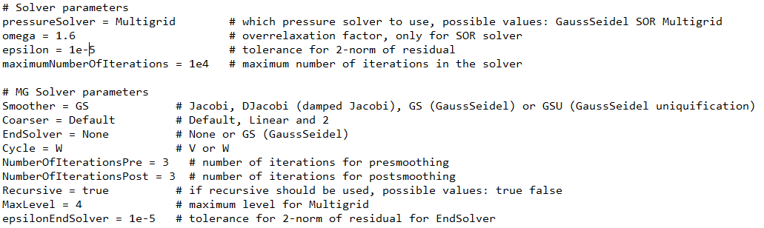
Anwendung
Auflösung | Multigrid | Faktor Level | SOR | Faktor Level | Faktor
8x8 | 184ms |  | 205ms |  | 0.898
16x16 | 1619ms | 8.799 | 2483ms | 12.112 | 0.652
32x32 | 12326ms | 7.613 | 57508ms | 23.161 | 0.214
64x64 | 98104ms | 7.959 | 1318225ms | 22.922 | 0.074
128x128 | 760543ms | 7.752
Notes:
Maxlevel linear mit auflösung erhöht

